Slide 1

Raamya Pandey (BMAI-C-WD-E-B12)
Audit & Analysis for Effective Digital Presence

Slide 2
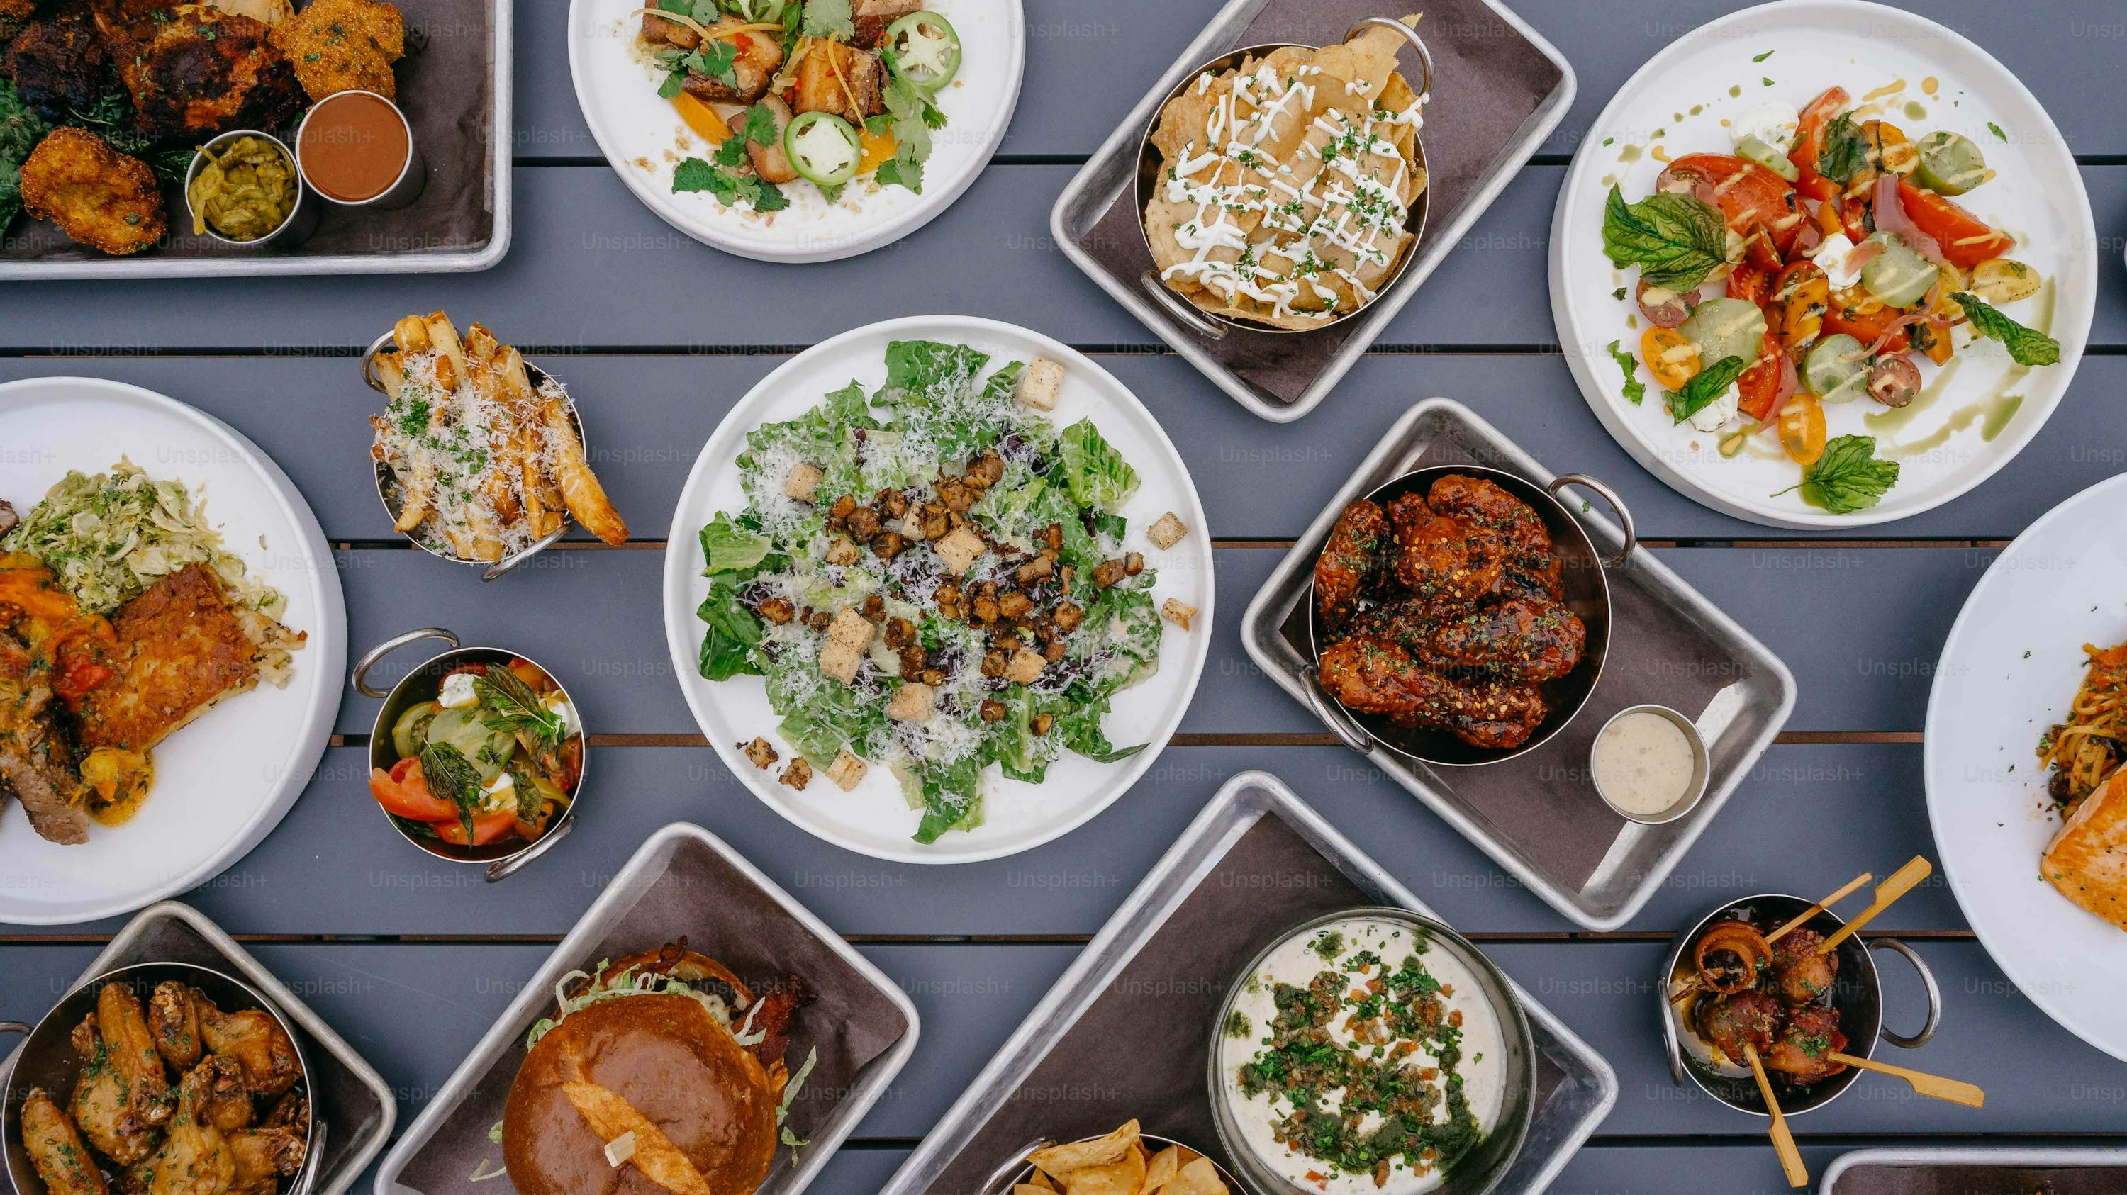

Company Overview
Hashmato
Started as Dineplan in 2008, rebranded to Hashmato in 2024
Offers POS & Retail Software for restaurants and retail businesses
The name “Hashmato” = Health + Tomato 🍅
Used in 2000+ locations across India, Singapore, Dubai & Myanmar

Slide 3
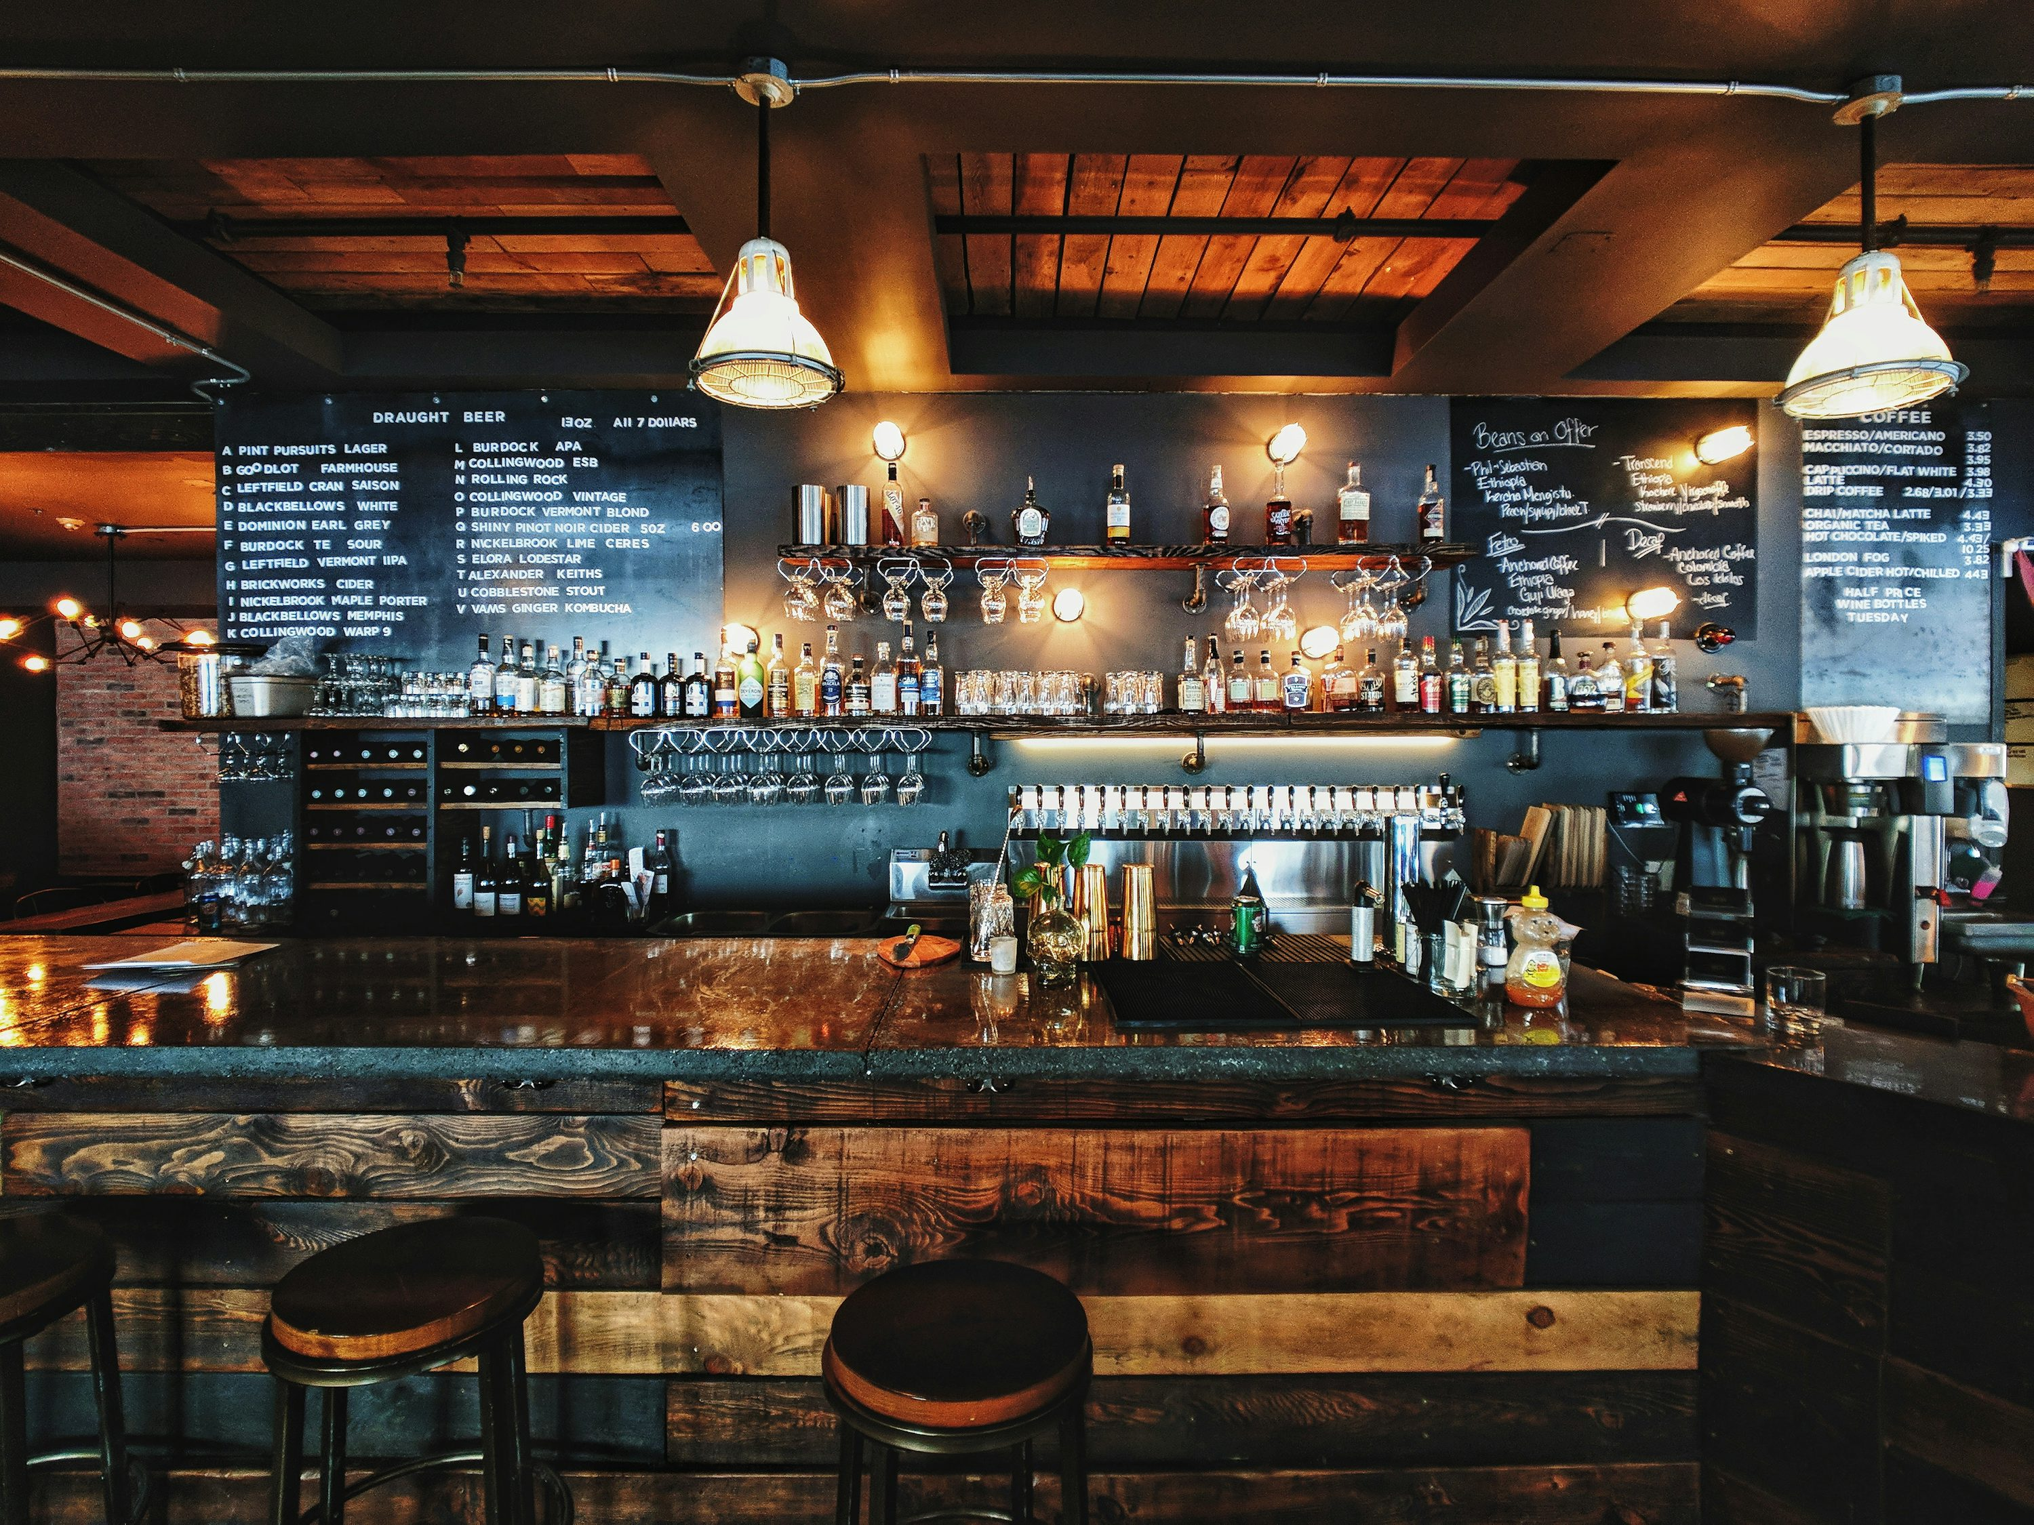

What Hashmato Offers :
POS billing, Inventory, Table & Order Management
Works on cloud, mobile, tablets – even offline
Extra features: Multilingual, CRM, loyalty programs, kiosk ordering
Integrates with UberEats, QuickBooks, WhatsApp alerts etc.

Slide 4

Outreach
Outreach
Outreach
Digital Presence & Audience
Targets
Active on
Outreach
Restaurants, Cafes, QSRs, Bakeries, Cloud Kitchens
Website, LinkedIn, Blogs, Case Studies
Uses both online & offline channels to connect with B2B customers

Slide 5
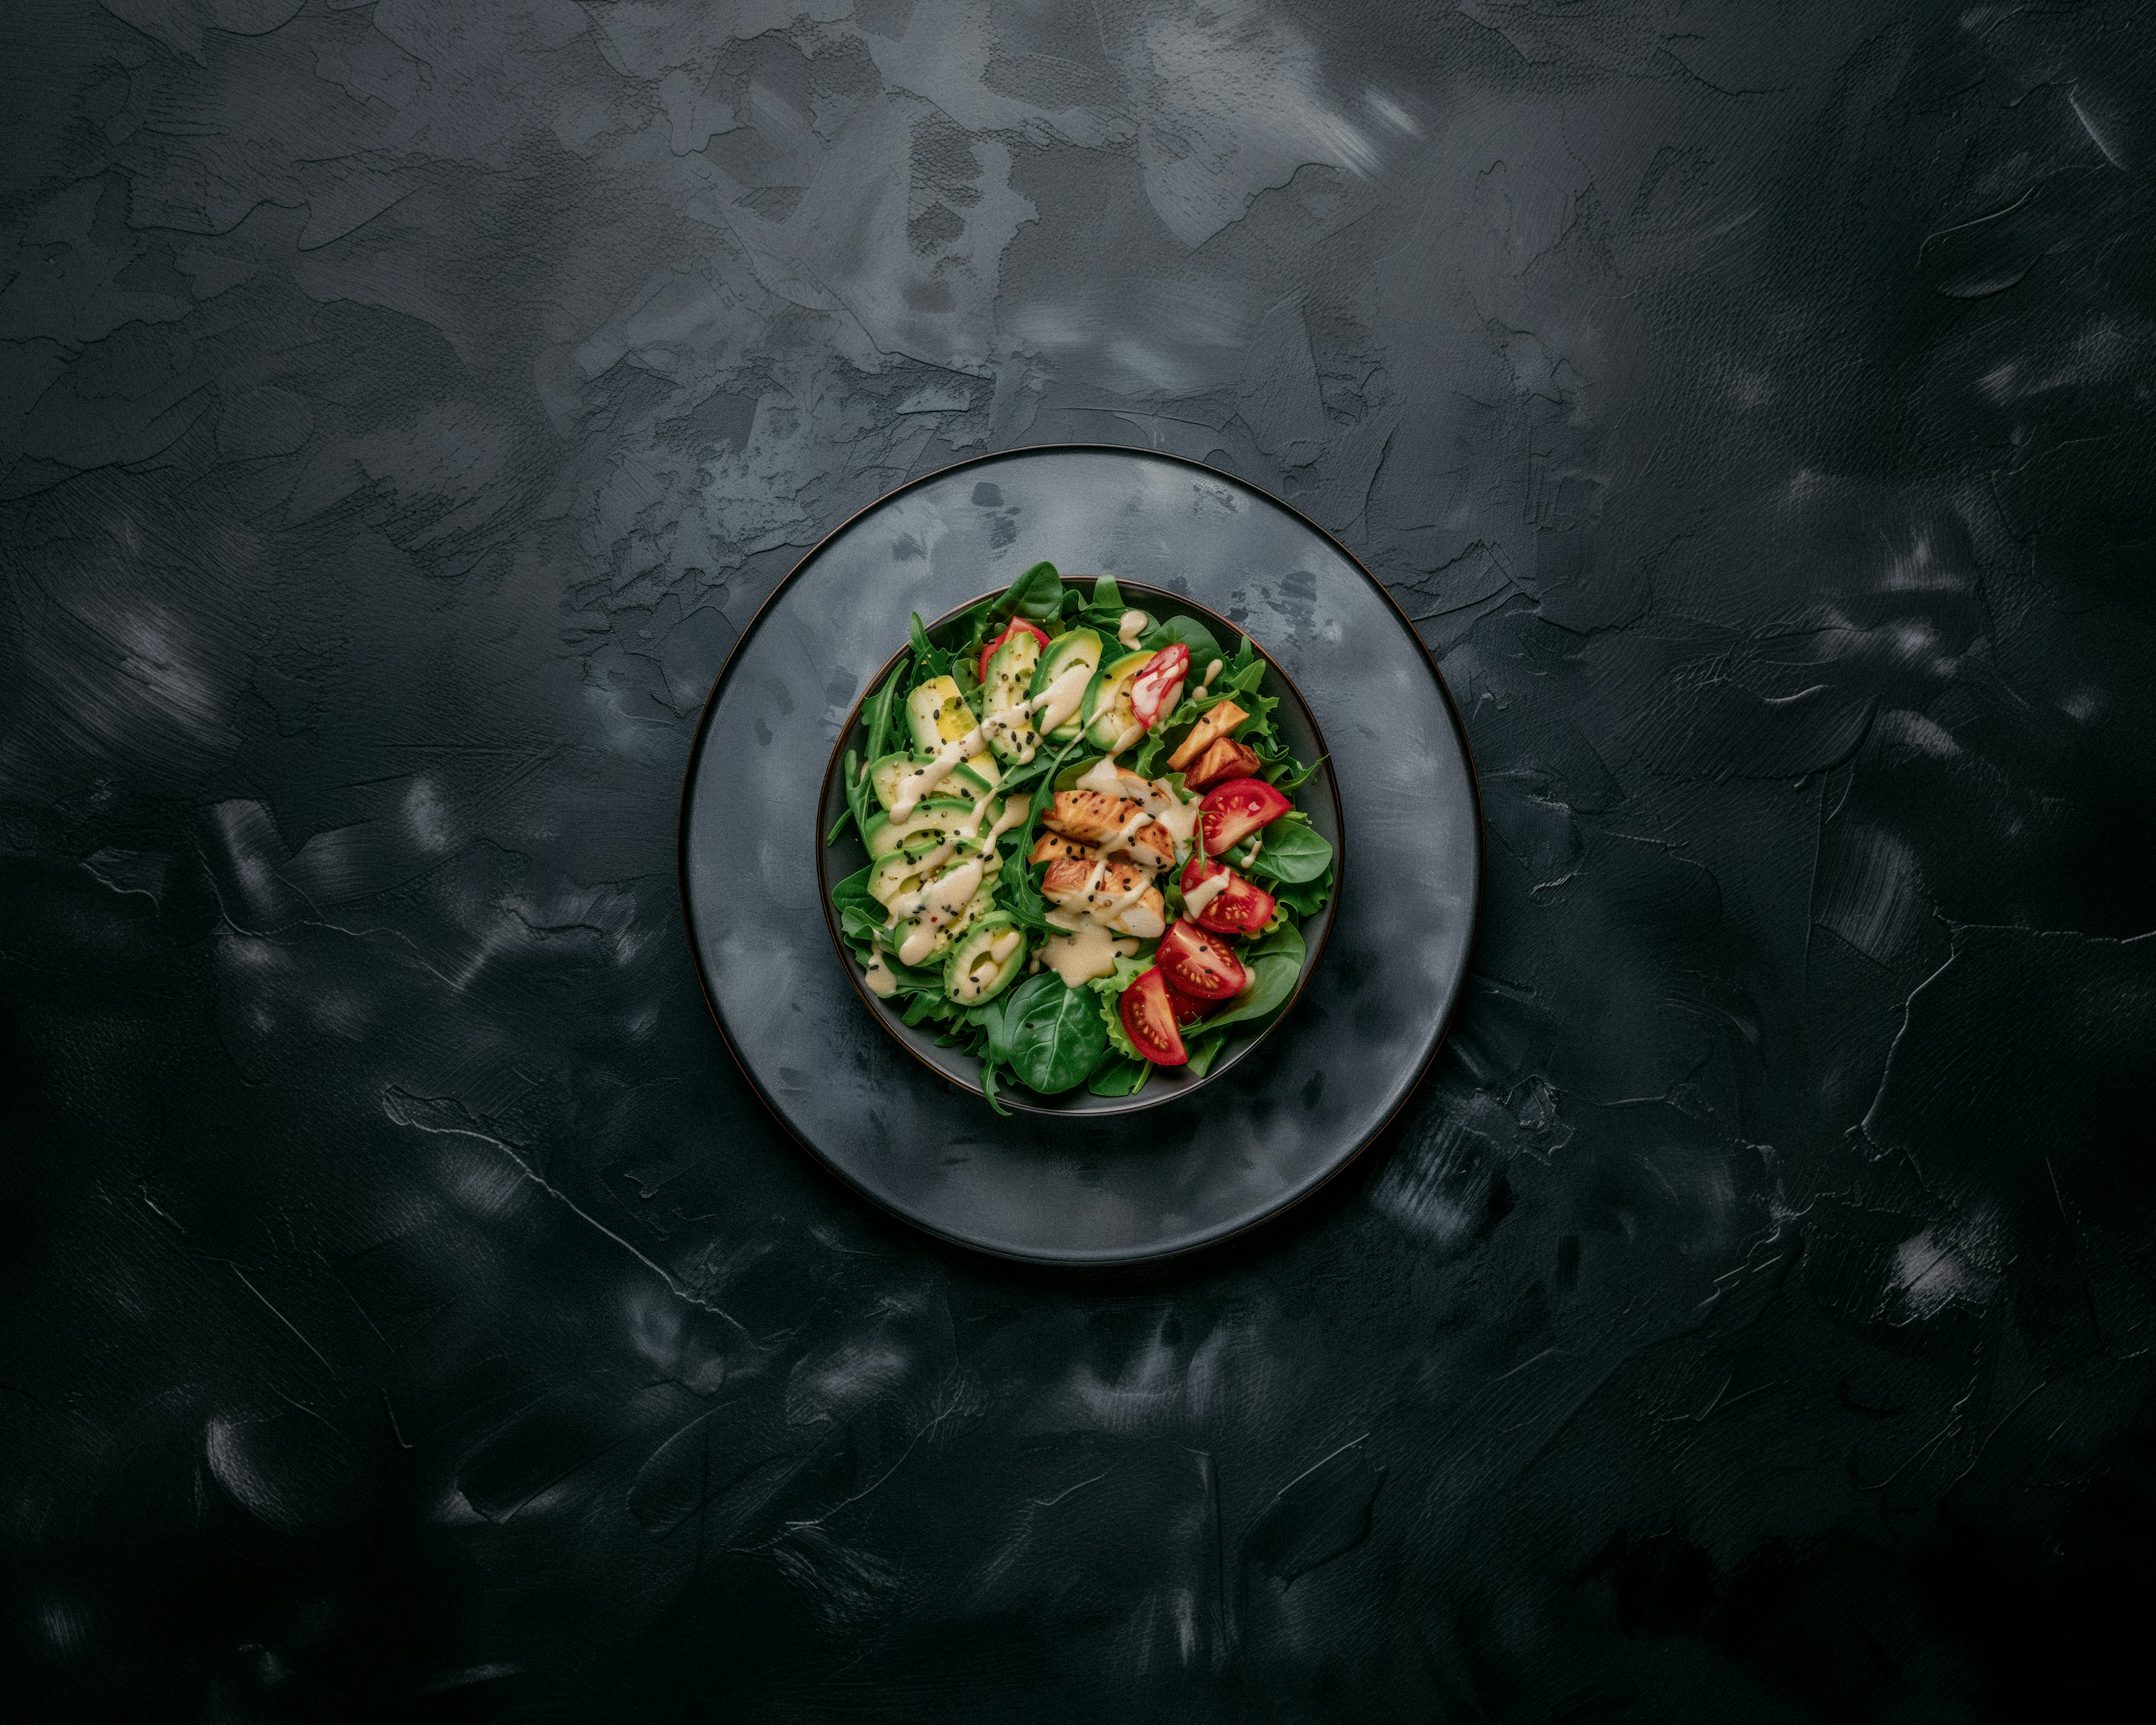
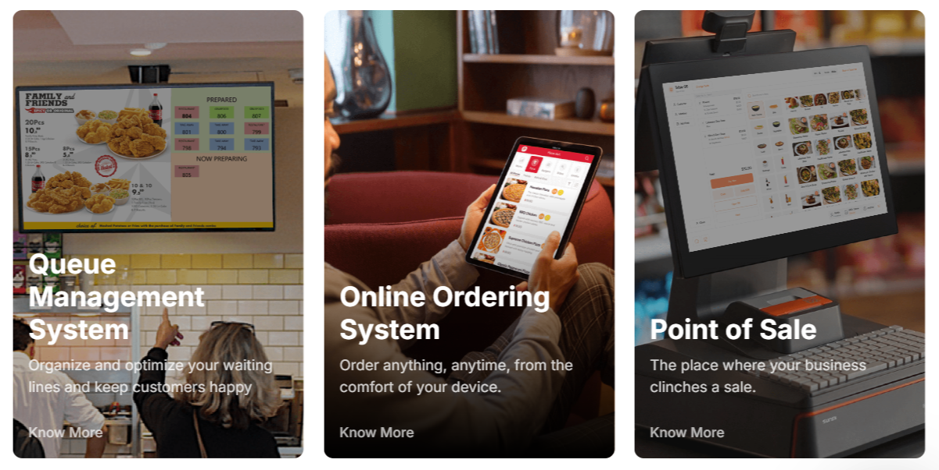
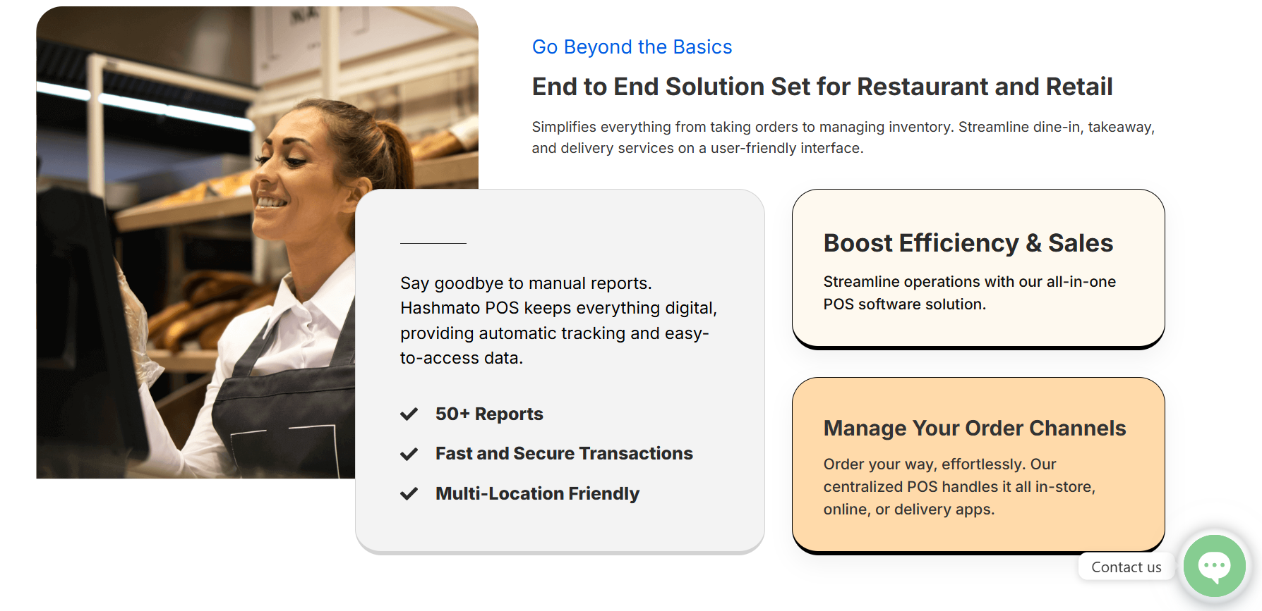
Website Audit – Design
Good
Clean layout and calming colors
Consistent brand feel
Works well on desktop and mobile
Needs Improvement
Slow loading due to large images
Some text is small or hard to read
CTAs/buttons not always visible on scroll

Slide 6


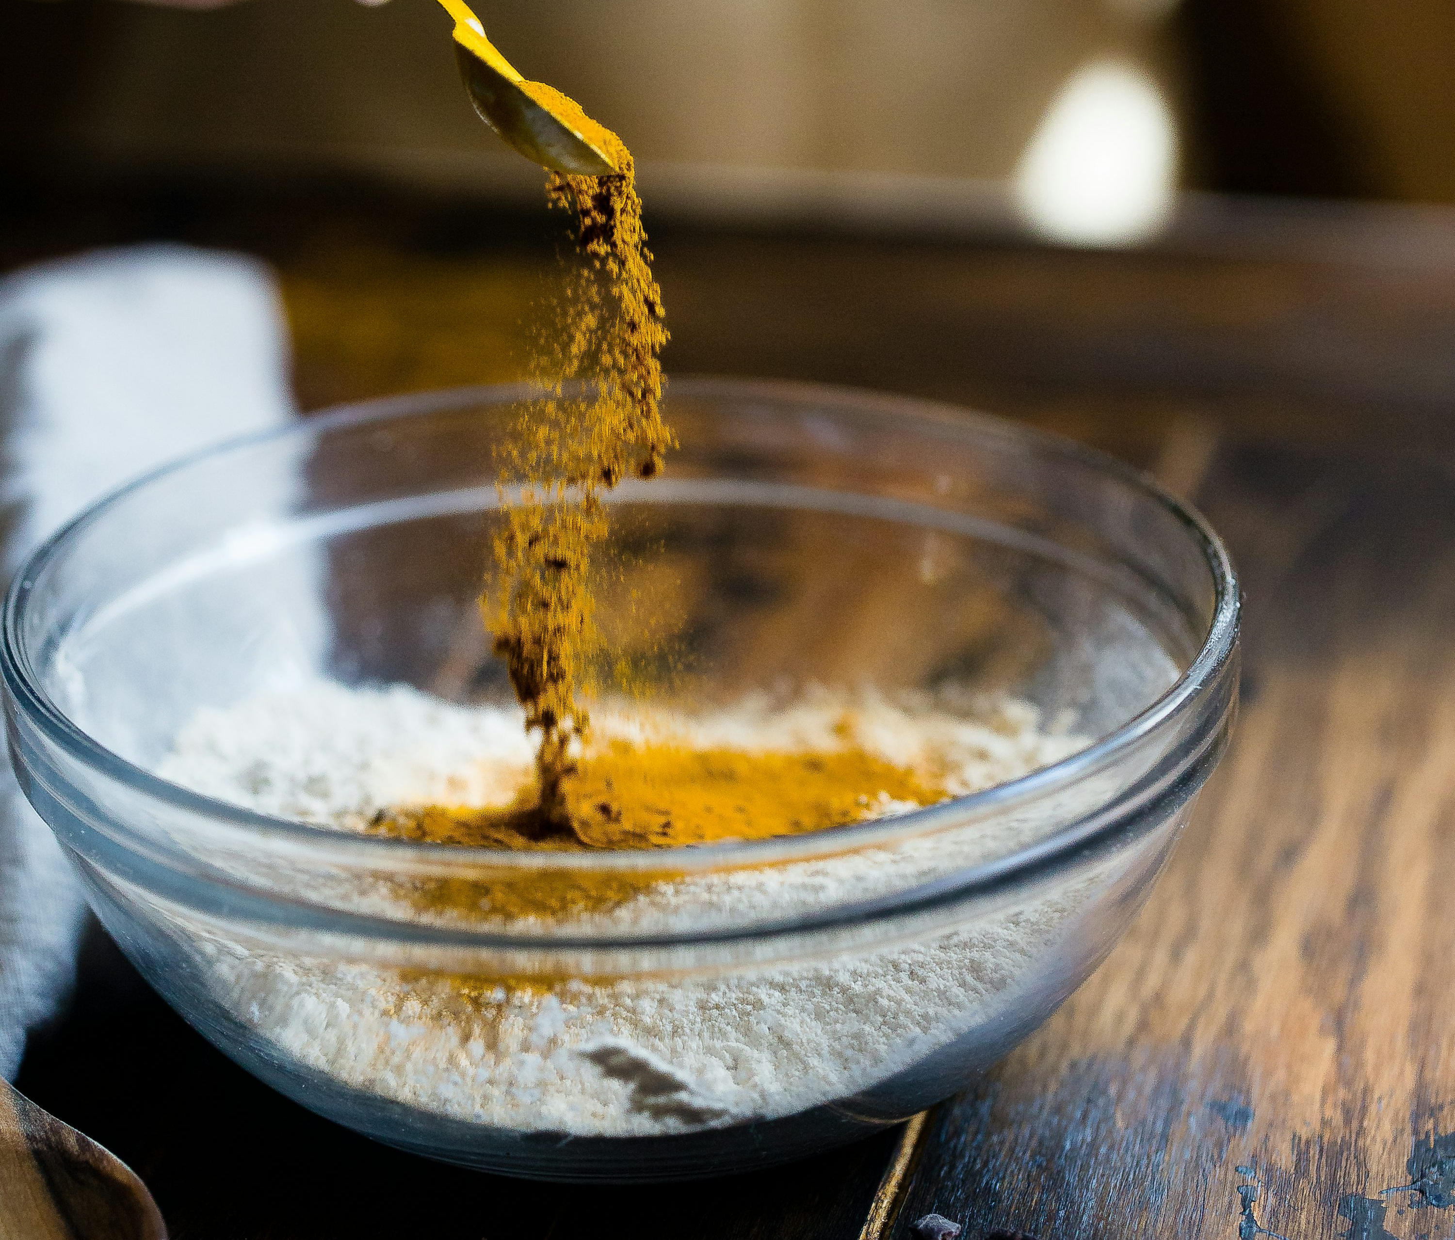
User Experience
Website Audit
( UX & SEO)
SEO Insights
Easy to navigate, mobile-friendly
Simple checkout, but missing trust badges
ALT text missing in some images
Meta titles and H1 used well
Needs keyword improvement
FCP = 3.6s (should be < 2s), TBT = 400ms (should be < 200ms)

Slide 7

SEO – Key Fixes Suggested
What’s Working | What to Improve
HTTPS secure | Add ALT text to all images
Mobile-friendly test passed | Write keyword-rich meta descriptions
Sitemap & robots.txt present | Compress images & minify code for speed

Slide 8
Marketing Strategy for Hashmato
Digital Suggestions
Start SEO blog with keywords like “POS for restaurants”.
Run retargeting ads on Google & Meta.
Use LinkedIn to share product demos, case studies.
Traditional Suggestions
Print brochures for trade shows.
In-store product demos.
Referral program for partners & happy clients.

Slide 9
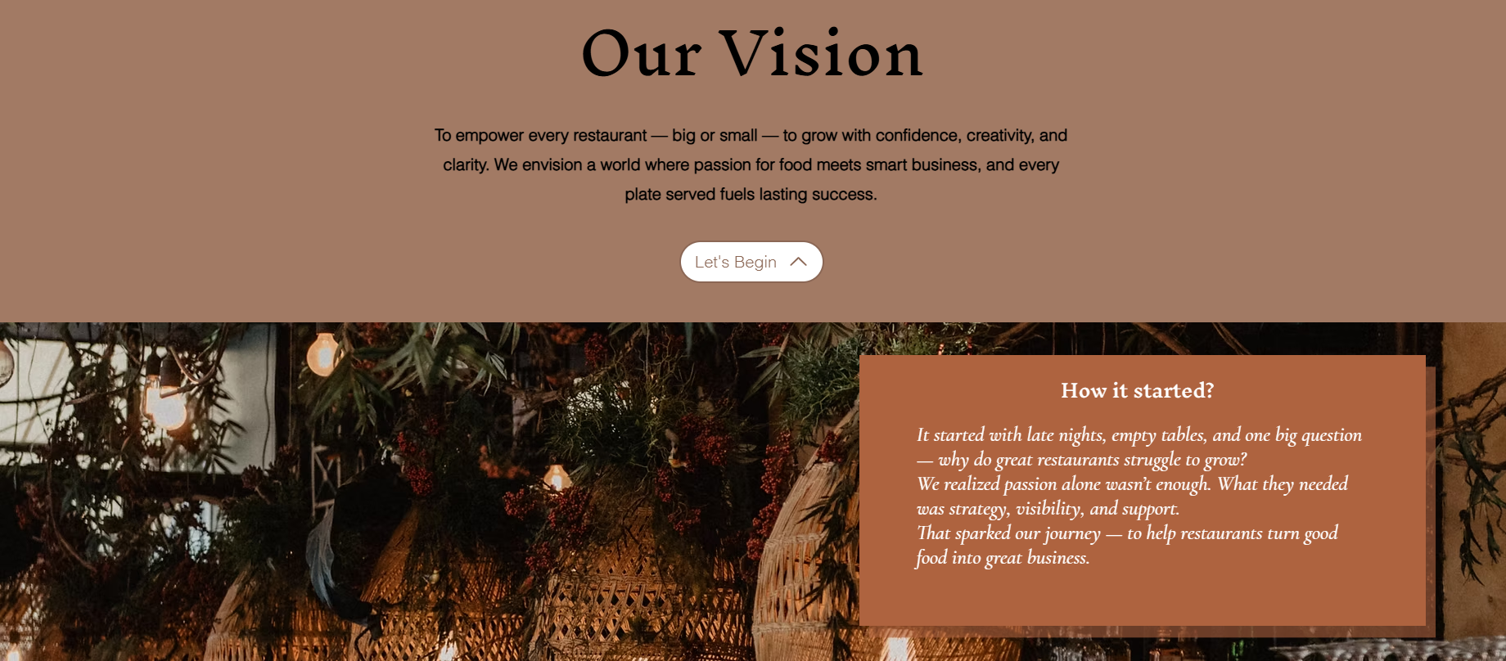
My Practical Project – RestroGrow (Wix)
Selected a clean design layout.
Added services, testimonials & contact form.
Made phone/email buttons clickable.
Optimized basic SEO (titles, descriptions, ALT text).
Ensured mobile-friendliness and smooth navigation.
https://restrogrow.wixsite.com/restrogrow

Slide 10

Learnings & Outcome
Key Takeaways
Understood how to audit and improve a live website
Built a user-friendly, SEO-ready page using no-code tools
Applied digital marketing ideas from Hashmato to RestroGrow
Gained real-world experience in improving digital presence

Slide 11

Thank you

